Slide 1
TCP

Slide 2
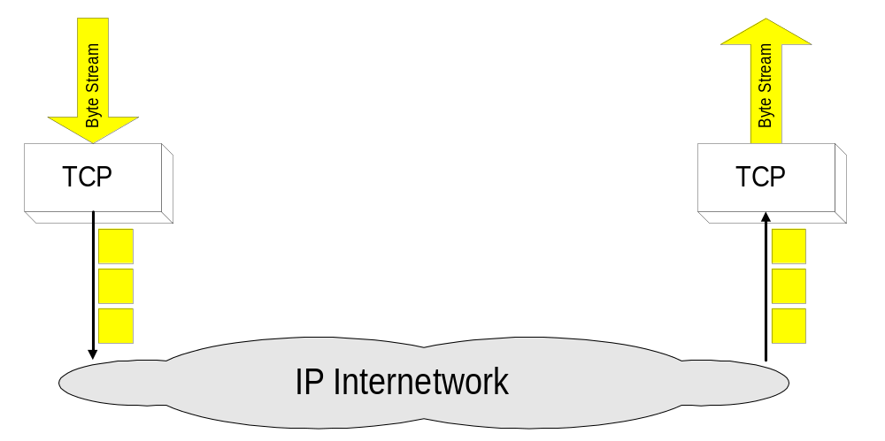
Overview
TCP = Transmission Control Protocol
Connection-oriented protocol
Provides a reliable unicast end-to-end byte stream over an unreliable internetwork.

Slide 3
TCP features
Guaranteed service protocol [RFC 793]
  Ensures that a packet has been received by the destination by using acknowledgments and retransmission
Connection oriented
  Applications need to establish a TCP connection prior to transfer
  3-way handshake
Full duplex
  Both ends can simultaneously read and write
Byte stream
  Ignores message boundaries
Flow and congestion control
  Source uses feedback to adjust transmission rate

Slide 4
TCP features
Acknowledgments from receiver
  Positive: “okay” or “ACK”
  Negative: “please repeat that” or “NACK” (not implemented for all TCP versions)
Timeout by the sender (“stop and wait”)
  Don’t wait indefinitely without receiving some response
  … whether a positive or a negative acknowledgment
Retransmission by the sender
  After receiving a “NACK” from the receiver
  After receiving no feedback from the receiver

Slide 5
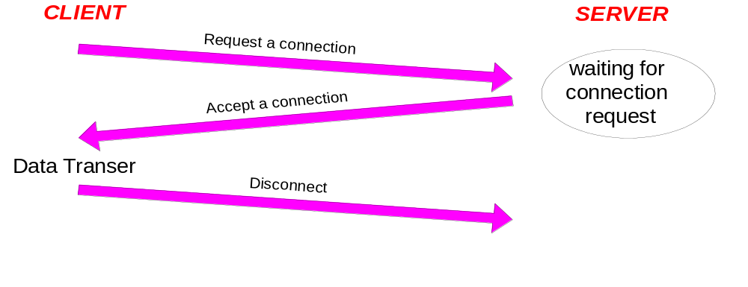
Connection-Oriented
Before any data transfer, TCP establishes a connection:
    One TCP entity is waiting for a connection (“server”)
    The other TCP entity (“client”) contacts the server
Each connection is full duplex

Slide 6
Challenges of Reliable Data Transfer
Over a perfectly reliable channel
  All of the data arrives in order, just as it was sent
  Simple: sender sends data, and receiver receives data
Over a channel with bit errors
  All of the data arrives in order, but some bits corrupted
  Receiver detects errors and says “please repeat that”
  Sender retransmits the data that were corrupted
Over a lossy channel with bit errors
  Some data are missing, and some bits are corrupted
  Receiver detects errors but cannot always detect loss
  Sender must wait for acknowledgment (“ACK” or “OK”)
  … and retransmit data after some time if no ACK arrives

Slide 7
Reliable
Byte stream is broken up into chunks which are called segments
  Receiver sends acknowledgments (ACKs) for segments
  TCP maintains a timer. If an ACK is not received in time, the segment is retransmitted
Detecting errors:
  TCP has checksums for header and data. Segments with invalid checksums are discarded
  Each byte that is transmitted has a sequence number

Slide 8
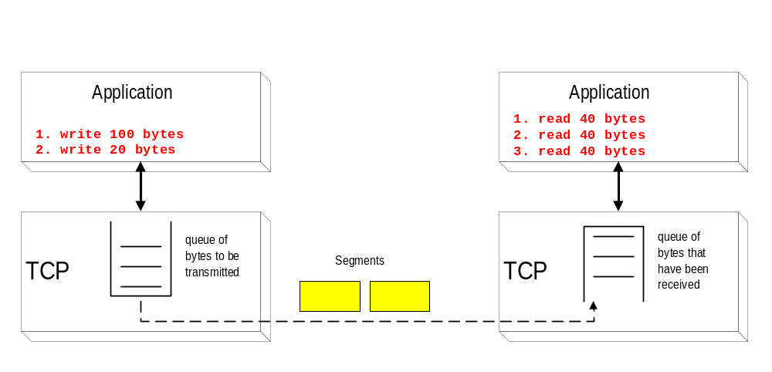
Byte Stream Service
To the lower layers, TCP handles data in blocks, the segments.
To the higher layers TCP handles data as a sequence of bytes and does not identify boundaries between bytes
So: Higher layers do not know about the beginning and end of segments !

Slide 9
Byte Stream Service
Host A
Byte 0
Byte 1
Byte 2
Byte 3
Byte 80
Host B
Byte 0
Byte 1
Byte 2
Byte 3
Byte 80

Slide 10
Emulated Using TCP “Segments”
Host A
Byte 0
Byte 1
Byte 2
Byte 3
Byte 80
Segment sent when:
Segment full (Max Segment Size),
Not full, but times out, or
“Pushed” by application.
TCP Data
TCP Data
Host B
Byte 0
Byte 1
Byte 2
Byte 3
Byte 80

Slide 11
TCP Segment
IP Data
TCP Data (segment)
TCP Hdr
IP Hdr
IP packet
  No bigger than Maximum Transmission Unit (MTU)
  E.g., up to 1500 bytes on an Ethernet
TCP packet
  IP packet with a TCP header and data inside
  TCP header is typically 20 bytes long
TCP segment
  No more than Maximum Segment Size (MSS) bytes
  E.g., up to 1460 consecutive bytes from the stream

Slide 12
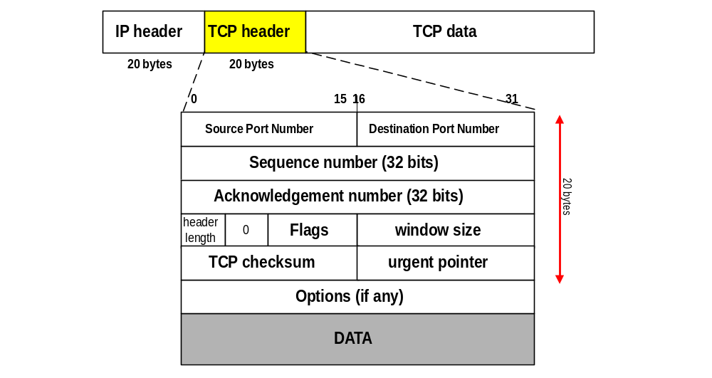
TCP Format
TCP segments have a 20 byte header with >= 0 bytes of data.

Slide 13
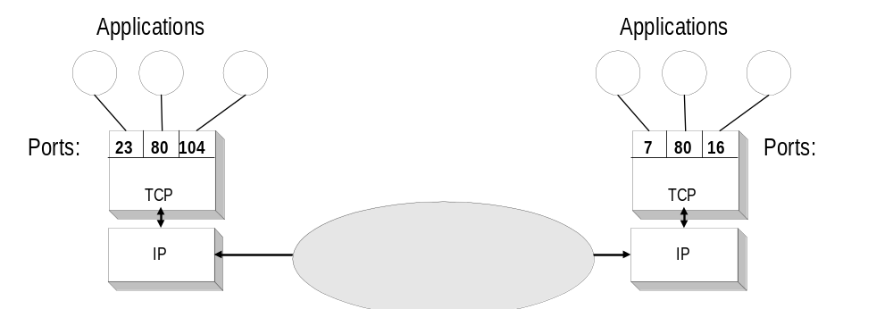
TCP header fields
Port Number:
    A port number identifies the endpoint of a connection.
    A pair <IP address, port number> identifies one endpoint of a connection.
    Two pairs <client IP address, client port number> and <server IP address, server port number> identify a TCP connection.

Slide 14
Port numbers
16-bit port numbers- 0 to 65535
  0 to 1023 set aside as well-known ports
  Assigned to certain common applications
  telnet uses 23, SMTP 25, HTTP 80 etc.
1024 to 49151 are registered ports
    Assigned by IANA for specific service upon application by a requesting entity.
    On most systems, registered ports can be used without superuser privileges.
  6000 through 6063 for X-window server
49152 through 65535 are dynamic or private ports, also called ephemeral ports

Slide 15
TCP header fields
Sequence Number (SeqNo):
  Sequence number is 32 bits long.
  So the range of SeqNo is
      0 <= SeqNo <= 2³² -1 ≈ 4.3 Gbyte
  Each sequence number identifies a byte in the byte stream
  Initial Sequence Number (ISN) of a connection is set during connection establishment
    A random number is taken as ISN
    Avoids the confusion due to data loss during previous connection
    Also better security is assured
    Though the time-based random number generation by the OS poses security threats

Slide 16
TCP header fields
Acknowledgement Number (AckNo):
  Acknowledgements are piggybacked, I.e
    a segment from A -> B can contain an acknowledgement for a data sent in the B -> A direction
  A host uses the AckNo field to send acknowledgements. (If a host sends an AckNo in a segment it sets the “ACK flag”)
  The AckNo contains the next SeqNo that a host wants to receive
  Example: The acknowledgement for a segment with sequence numbers 0-1500 is AckNo=1501

Slide 17
Sequence Numbers
Host A
ISN (initial sequence number)
Sequence number = 1st byte
TCP
HDR
TCP Data
ACK sequence number = next expected byte
TCP Data
TCP
HDR
Host B

Slide 18
TCP header fields
Acknowledge Number (cont’d)
  TCP uses the sliding window flow protocol to regulate the flow of traffic from sender to receiver
  TCP uses the following variation of sliding window:
      no NACKs (Negative ACKnowledgement)
      only cumulative ACKs
Example:
  Assume: Sender sends two segments with “1..1500” and “1501..3000”, but receiver only gets the second segment.
  In this case, the receiver cannot acknowledge the second packet. It can only send AckNo=1

Slide 19
TCP header fields
Header Length ( 4bits):
  Length of header in 32-bit words
  Note that TCP header has variable length (with minimum 20 bytes)

Slide 20
TCP header fields
Flag bits:
  URG: Urgent pointer is valid
      If the bit is set, the following bytes contain an urgent message in the range:
        SeqNo <= urgent message <= SeqNo+urgent pointer
  ACK: Acknowledgement Number is valid
  PSH: PUSH Flag
      Notification from sender to the receiver that the receiver should pass all data that it has to the application.
      Normally set by sender when the sender’s buffer is empty

Slide 21
TCP header fields
Flag bits:
  RST: Reset the connection
      The flag causes the receiver to reset the connection
      Receiver of a RST terminates the connection and indicates higher layer application about the reset
  SYN: Synchronize sequence numbers
      Sent in the first packet when initiating a connection
  FIN: Sender is finished with sending
      Used for closing a connection
      Both sides of a connection must send a FIN

Slide 22
TCP header fields
Window Size:
  Each side of the connection advertises the window size
  Window size is the maximum number of bytes that a receiver can accept.
  Maximum window size is 2¹⁶-1= 65535 bytes
TCP Checksum:
  TCP checksum covers over both TCP header and TCP data (also covers some parts of the IP header)
Urgent Pointer:
  Only valid if URG flag is set

Slide 23
TCP Options
Maximum Segment Size (MSS)
Window scaling
Selective Acknowledgements (SACK)
Timestamps
NOP

Slide 24
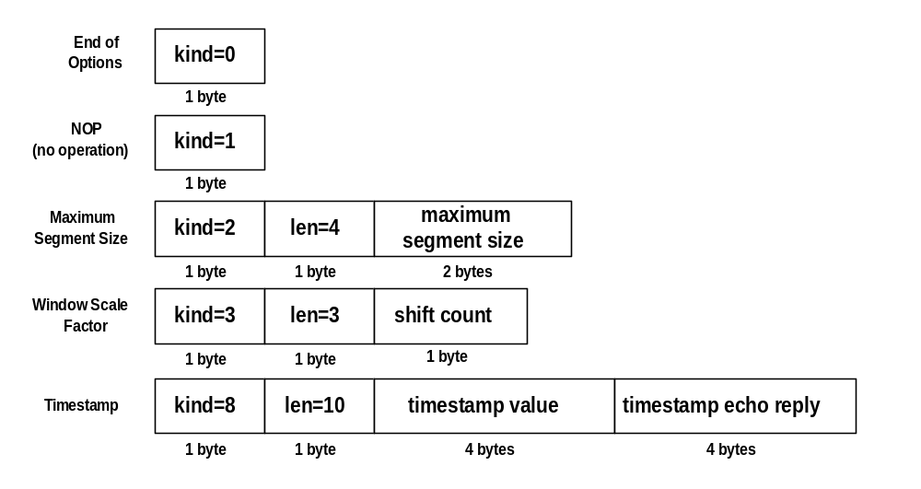
TCP header fields
Options: In all cases, len is the total length in bytes of option

Slide 25
TCP header fields
Options:
  NOP is used to pad TCP header to multiples of 4 bytes
  Maximum Segment Size
    defined as the largest block of data that a sender using TCP will send to the receiver.
    when a connection is initiated a SYN segment is sent (discussed later),
    in the process of sending a SYN segment, the sender has the option of announcing its MSS,
    TCP assumes a default of 536bytes (minus the 20 byte TCP header) (when a sender doesn’t use the options field to declare the MSS)

Slide 26
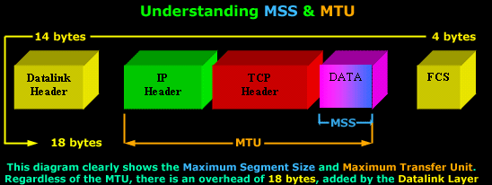
TCP Options
Maximum Segment Size
If the MSS option is omitted by one or both ends of the connection, then the value of 536 bytes will be used (defined by RFC 1122 and is calculated by taking the default value of an IP Datagram, 576 bytes, minus the standard length of the IP and TCP Header (40 bytes), which gives us 536 bytes).

Slide 27
TCP header fields
Options:
  NOP
  Maximum Segment Size
  Window Scale Options
        Increases the16-bit window field to 32 bits in length, i.e., the window size is interpreted differently
        This option can only be used in the SYN segment (first segment) during connection establishment time

Slide 28
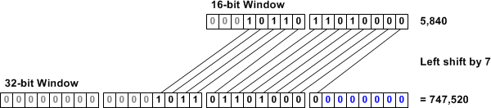
TCP Options
Window Scaling
Defined in RFC 1072 (redefined in 1323), which lets a system advertise 30-bit (16 from the original window + 14 from the TCP Options) Window size values, with a maximum buffer size of 1 GB
Primarily created for high-latency, high-bandwidth WAN links where a limited Window size can cause severe performance problems.

Slide 29
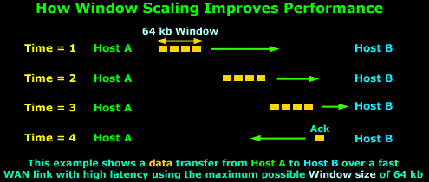
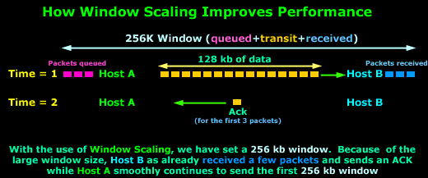
TCP Options
Without window scaling
With window scaling

Slide 30
TCP Options
Selective Acknowledgments (SACK)
Introduced with RFC 1072
Classical TCP does not allow “selective acknowledgment”
When a TCP connection is established using 3-way-handshake the hosts must send a "Selective Acknowledgments Permitted" in the TCP Options to indicate that they are able to use SACKs
SACK field in the TCP Options uses two 16 bit fields, to specify the range of bytes it received
In the case where Window Scaling is also used, these fields can be expanded to two 24 or 32 bit fields
Current Implementations : Windows XP/2000/ME/98, Solaris 7 and later, Free BSD & NetBSD have optional modules
Kind = 5 Length = 2

Slide 31
SACK Message
Source Port Address Destination Port Address
Sequence Number
Cumulative Acknowledgement Number
HLEN Window Size
Checksum Urgent Pointer
Kind = 1 Kind = 1
Kind = 5
Length ?
Left Edge of First Block
Right Edge of First Block
Left Edge of last Block
Right Edge of last Block

Slide 32
TCP Options
Timestamp
Used to calculate round trip time
Timestamp option must be sent during the 3-way-handshake in order to enable its use during any subsequent segments
The Timestamp field consists of a Timestamp Echo and Timestamp Reply field
The reply field is always set to zero by the sender and completed by the receiver
NOP
Used to pad TCP header to multiples of 4 bytes and to separate the different options
Its implementation depends on the operating system used
For example, if options MSS and SACK are used, Windows XP will usually place two nops between them
Often checked by hackers when trying to determine the remote host's operating system.

Slide 33
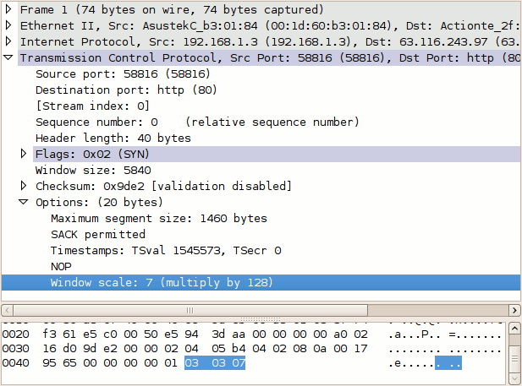
TCP header fields

Slide 34
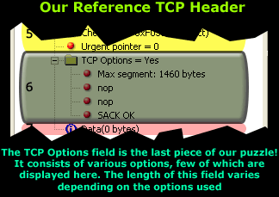
TCP header fields
Ref: www.firewall.cx

Slide 35
Connection Management in TCP
Opening a TCP Connection
Closing a TCP Connection
Special Scenarios
State Diagram

Slide 36
TCP Connection Establishment
TCP uses a three-way handshake to open a connection:
(1) ACTIVE OPEN: Client sends a segment with
      SYN bit set *
      port number of client
      initial sequence number (ISN) of client
(2) PASSIVE OPEN: Server responds with a segment with
      SYN bit set *
      initial sequence number of server
      ACK for ISN of client
  (3) Client acknowledges by sending a segment with:
      ACK ISN of server (* counts as one byte)

Slide 37
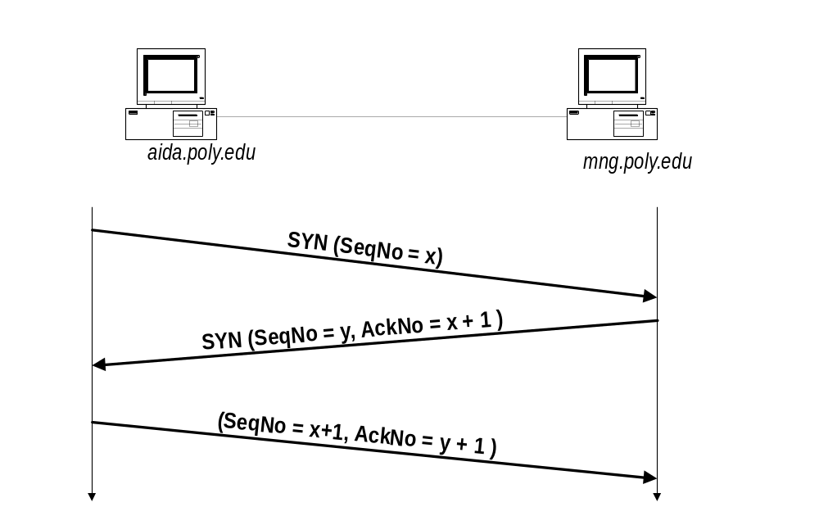
Three-Way Handshake

Slide 38
TCP Header
Source port
Destination port
Sequence number
Flags:
SYN
FIN
RST
PSH
URG
ACK
Acknowledgment
HdrLen
0
Flags
Advertised window
Checksum
Urgent pointer
Options (variable)
Data

Slide 39
Step 1: A’s Initial SYN Packet
A’s port
B’s port
A’s Initial Sequence Number
Flags:
SYN
FIN
RST
PSH
URG
ACK
Acknowledgment
20
Flags
Advertised window
0
Checksum
Urgent pointer
Options (variable)
A tells B it wants to open a connection…

Slide 40
Step 2: B’s SYN-ACK Packet
B’s port
A’s port
B’s Initial Sequence Number
Flags:
SYN
FIN
RST
PSH
URG
ACK
A’s ISN plus 1
20
Flags
Advertised window
0
Checksum
Urgent pointer
Options (variable)
B tells A it accepts, and is ready to hear the next byte…
… upon receiving this packet, A can start sending data

Slide 41
Step 3: A’s ACK of the SYN-ACK
A’s port
B’s port
Sequence number
Flags:
SYN
FIN
RST
PSH
URG
ACK
B’s ISN plus 1
20
Flags
Advertised window
0
Checksum
Urgent pointer
Options (variable)
A tells B it is okay to start sending
… upon receiving this packet, B can start sending data

Slide 42
What if the SYN Packet Gets Lost?
Suppose the SYN packet gets lost
  Packet is lost inside the network, or
  Server rejects the packet (e.g., listen queue is full)
Eventually, no SYN-ACK arrives
  Sender sets a timer and waits for the SYN-ACK
  … and retransmits the SYN if needed
How should the TCP sender set the timer?
  Sender has no idea how far away the receiver is
  Hard to guess a reasonable length of time to wait
  Some TCPs use a default of 3 or 6 seconds

Slide 43
TCP Connection Termination
Each end of the data flow must be shut down independently (“half-close”)
If one end is done it sends a FIN segment. This means that no more data will be sent
Four steps involved:
  (1) X sends a FIN to Y (active close)
  (2) Y ACKs the FIN,
  (at this time: Y can still send data to X)
  (3) and Y sends a FIN to X (passive close)
  (4) X ACKs the FIN.

Slide 44
TCP Connection Termination
Client
Server
Active close
segment 1
FIN M
ACK M+1
Passive close
segment 2
data
FIN N
Segment 3
Half close
Segment 4
ACK N+1

Slide 45
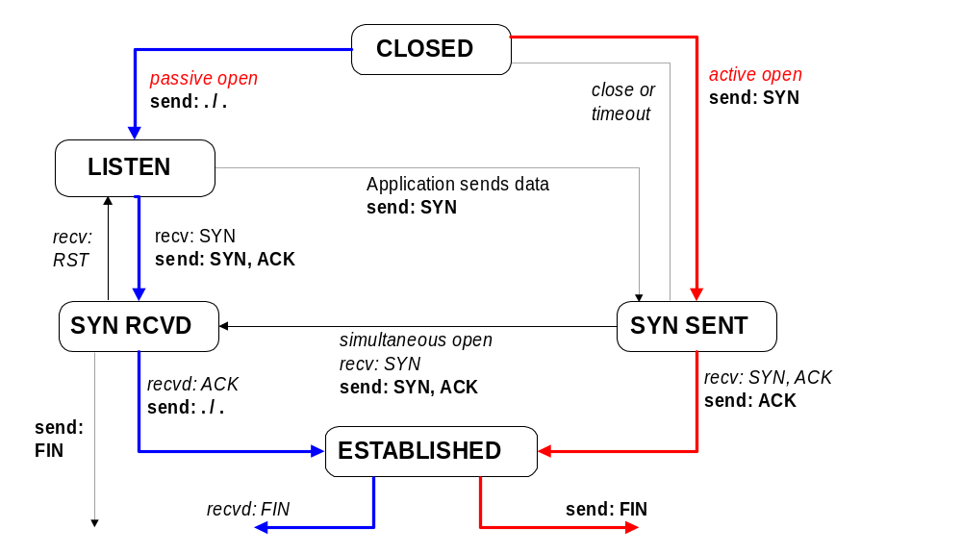
TCP State Transition Diagram
Opening A Connection

Slide 46
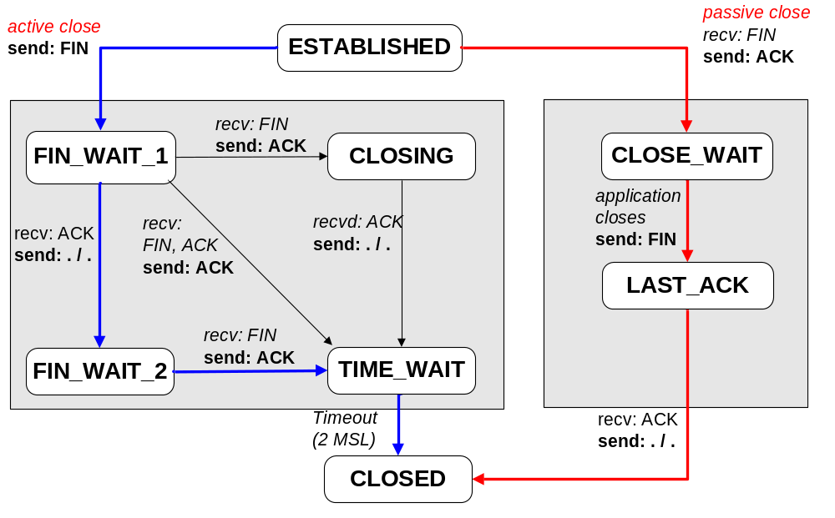
TCP State Transition Diagram
Closing A Connection

Slide 47
2MSL Wait State
2MSL Wait State = TIME_WAIT
When TCP does an active close, and sends the final ACK, the connection must stay in the TIME_WAIT state for twice the maximum segment lifetime.
2MSL= 2 * Maximum Segment Lifetime
MSL is the longest period of time that a packet can remain undelivered in the network (an estimate rather than a guarantee)
The MSL is set to 2 minutes or 1 minute or 30 seconds.
Why 2 MSL?
TCP requires that the endpoint that initiates an active close of the connection eventually enters TIME-WAIT

Slide 48
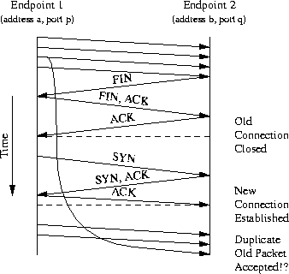
2MSL Wait State
Though, the situation is quite unlikely as the address, port number and ISN may not match.

Slide 49
2MSL Wait State
The second reason for the TIME_WAIT state is to implement TCP's full-duplex connection termination reliably.
If the final ACK from end point 2 is dropped then the end point 1 will resend the final FIN.
If the connection had transitioned to CLOSED on end point 2 then the only response possible would be to send an RST
(the retransmitted FIN would be unexpected)
This would cause end point 1 to receive an error even though all data was transmitted correctly
Hence the TIME_WAIT state is introduced to avoid the above error situation

Slide 50
Resetting Connections
Resetting connections is done by setting the RST flag
When is the RST flag set?
  Connection request arrives and no server process is waiting on the destination port
  Abort (Terminate) a connection
  Causes the receiver to throw away buffered data. Receiver does not acknowledge the RST segment
  13-09-19 – 01, 43, 57, 06, 47, 76, 31, 74, 34

